Slide 1

BBTalk - Submission and Connection Management Tool
Eleni Tsoulouha

Slide 2
Thesaurus Maintenance WG
The TMWG aims:
  to develop a model to render existing terminologies used across the humanities interoperable and effectively managed.
  to assist scholarly communities build and publish thesauri/structured vocabularies following a set of sound methodological principles.
To this end:
  The TMWG has built the BackBone Thesaurus (BBT), an overarching thesaurus for the Humanities, under which the vocabularies used by scholarly communities can be aligned.
  The TMWG has developed an online service facilitating
    integration of thesauri with the BBT, and
    managing the content of BBT.

Slide 3
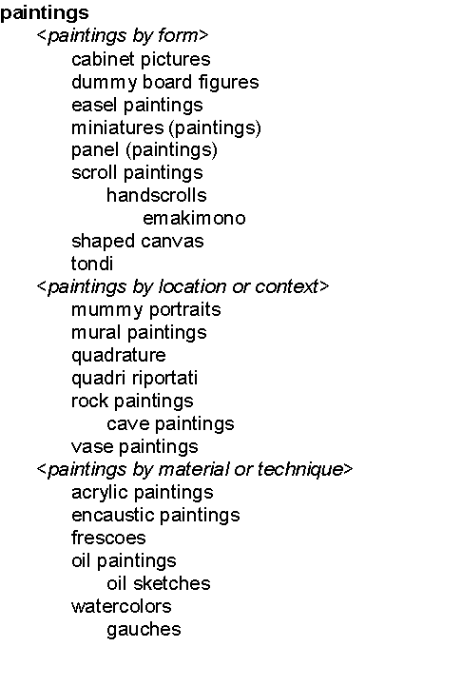

Use of BBT as an overarching thesaurus
...
Backbone thesaurus
Backbone thesaurus
9
6
5
11
7
12
10
8
12
15
6
7
16
9
8
11
Activities
Activities
Conceptual Objects
Conceptual Objects
13
2
10
17
1
3
1
14
2
4
4
13
14
Materials
3
5
Materials
Physical Objects
Physical Objects
Controlled
Vocabulary A
Controlled
Vocabulary B
Local Thesaurus B
Local
Thesaurus A
Local
Maintainer
Local
Maintainer
Notes:
Different local thesaurus maintainers are working independently, following their own disciplines, based on their own terminology.
In order for multiple existing thesauri to become interoperable (click),
we need a common set of high-level concepts:
to enable the classification in a consistent and objective way
to ensure compatibility among different thesauri
Thus we came up with BackBone Thesaurus (aka BBT), an overarching thesaurus for the humanities, under which all the vocabularies and terminologies in use in the domain can be aligned.
This grey triaglular area (click) represents BBT, under which we expect local maintainers to align their thesauri, without being forced to abandon their terminology.

Slide 4
The Structure of BBT
Activities (facet)
- activities (top term)
- - disciplines
- - functions
- - human interactions
- - intensional desctructions
Conceptual Objects (facet)
- conceptual objects (top term)
- - symbolic objects
- - propositional objects
- - methods
- - concepts
Geopolitical Units (facet)
- geopolitical units (top term)
Groups and Collectivities(facet)
- groups and collectivities(top term)
Material Things (facet)
- material things (top term)
- - built environment
- - mobile objects
- - physical features
- - structural parts of material objects
Materials (facet)
- materials (top term)
Natural Processes (facet)
- natural processes (top term)
- - geneses
- - natural destructions
Roles (facet)
- roles (top term)
- - offices
- - roles of interpersonal relations
Types of Epochs (facet)
- types of epochs (top term)

Slide 5
BBTalk - Submission and Connection Management Tool
BBT integration:
enabling thesauri maintainers to align thesauri /structured vocabularies with the BBT
  allows users browse through BBT facets & hierarchies (obsolete ones too), before they decide on the appropriate ones, which branches of their thesaurus are to be linked with
  allows them to link their terms to BBT, by creating connections between LOD identified BBT terms and thesauri terms
  notifies interested parties on changes implemented on BBT

Slide 6
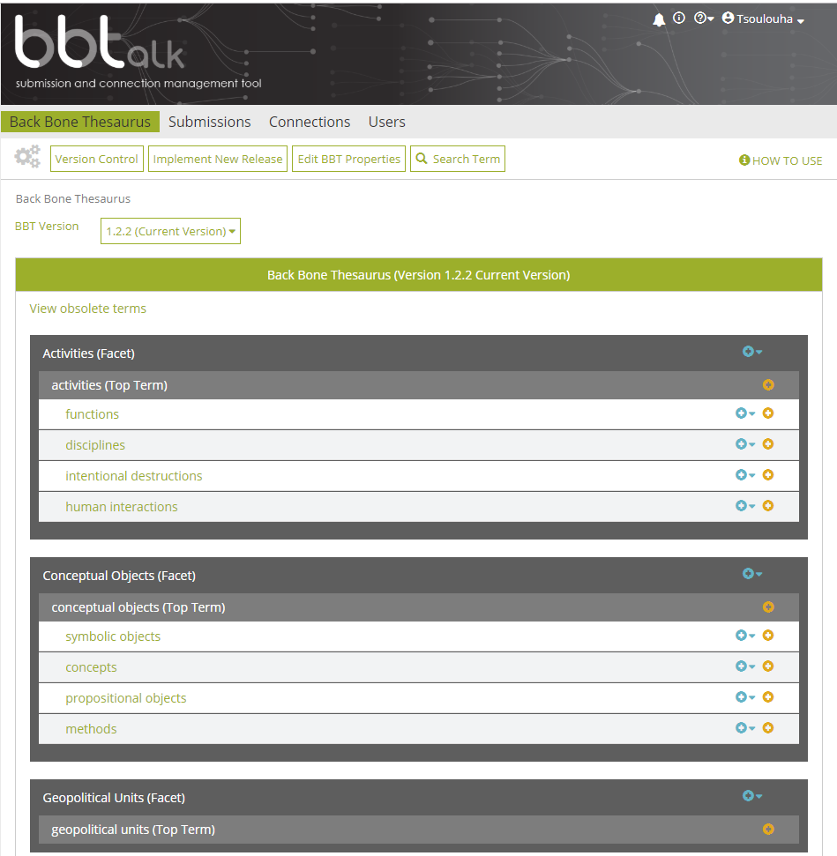
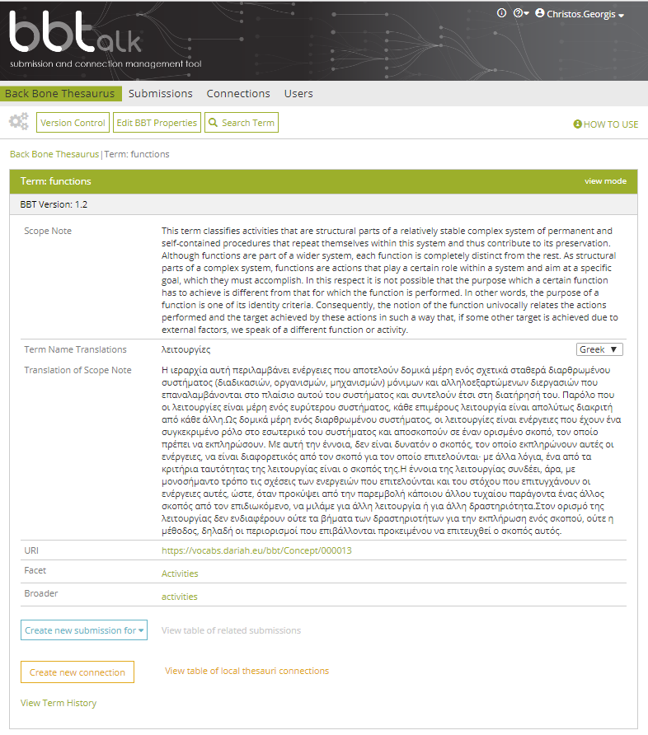
Browse the BBT

Slide 7
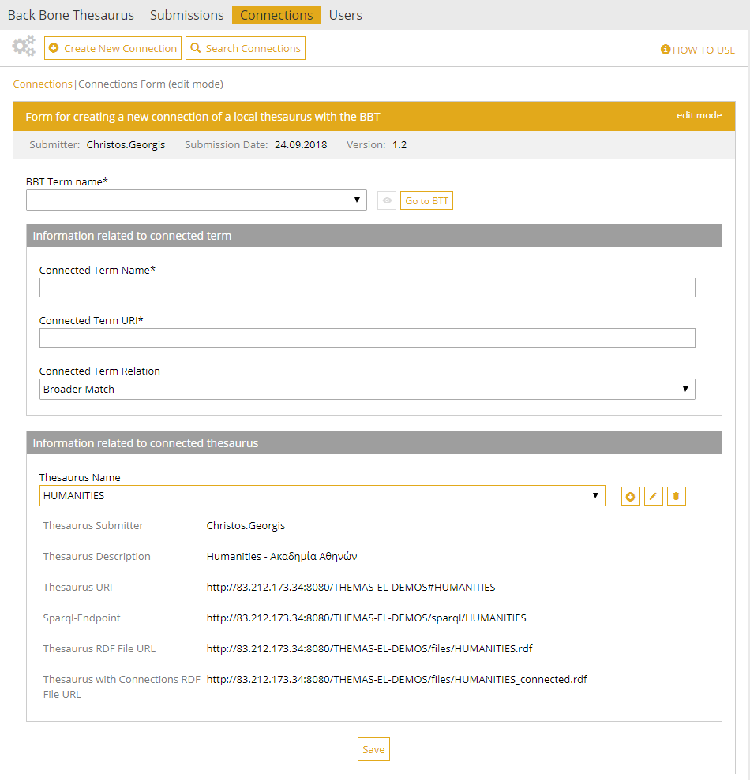
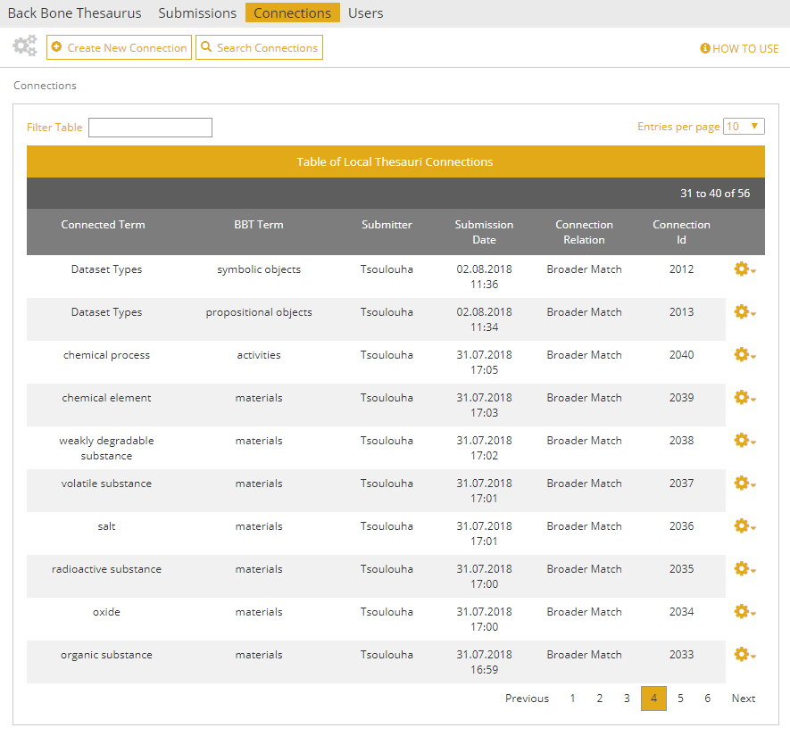
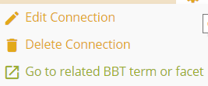
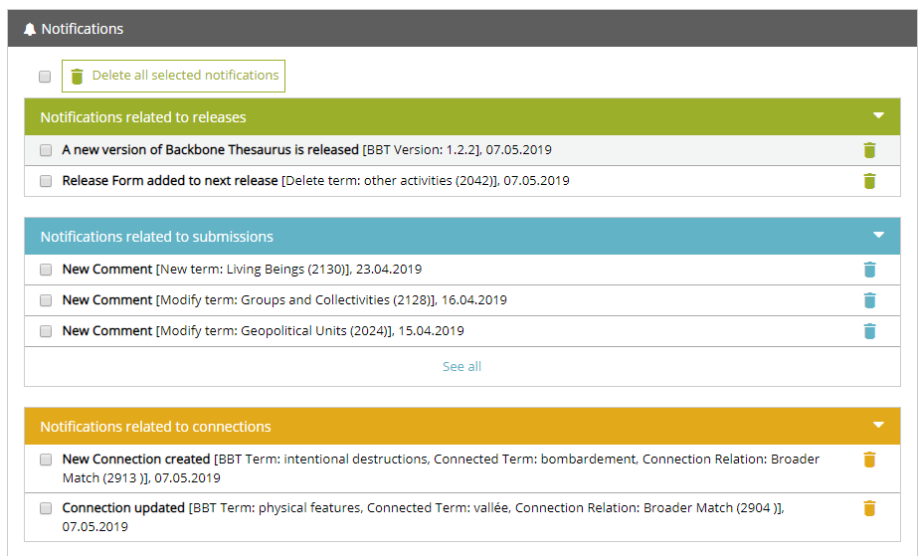
Aligning thesauri to the BBT

Slide 8
BBTalk - Submission and Connection Management Tool
Managing BBT content
proposing and deciding on implementing changes (“submissions”):
  allows users to submit requests for changes (“submissions” regarding the facets and the hierarchies of BBT)
  supports discussions among the curators of BBT (and its users) regarding the proposed changes, until consensus is reached
  allows BBT curators to directly contact other users regarding open issues and ask for expert opinion.
  keeps track of the different versions of BBT and the history of the submissions (related past discussions)
  notifies interested parties about the progress of a submission

Slide 9
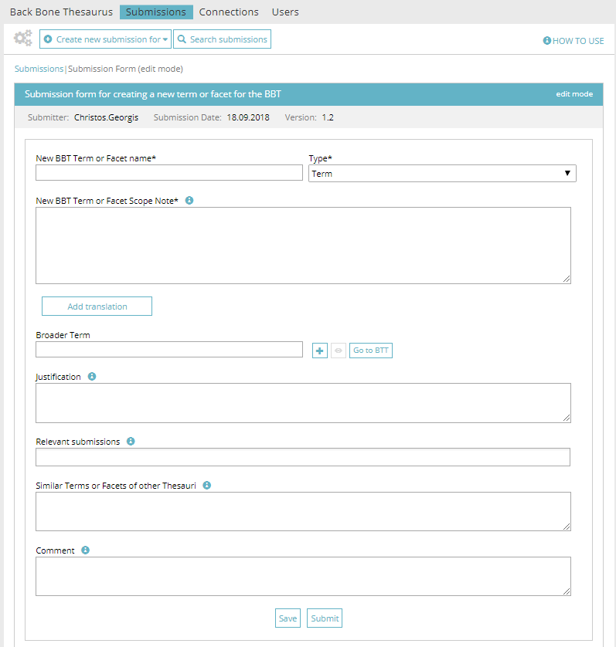
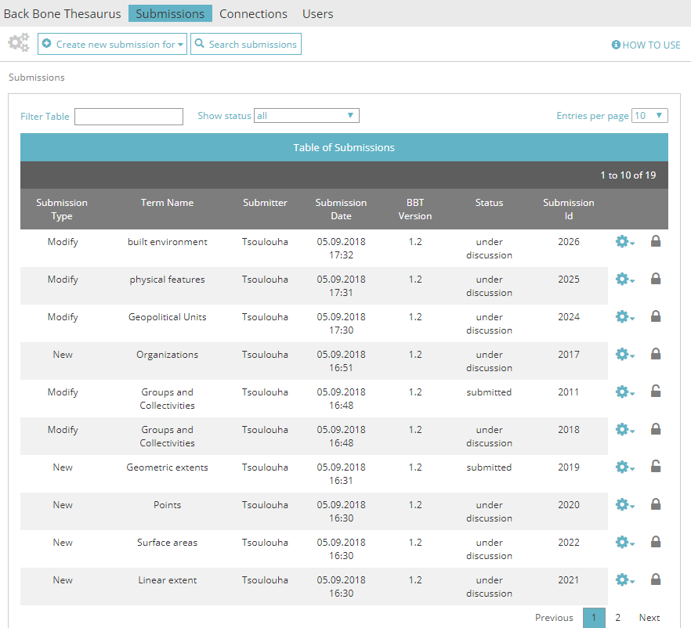

Managing Submissions
Types of submissions:
  Add new term/facet
  Delete term/facet
  Modify term/facet
  Merge terms/facets
  Split term/facet

Slide 10
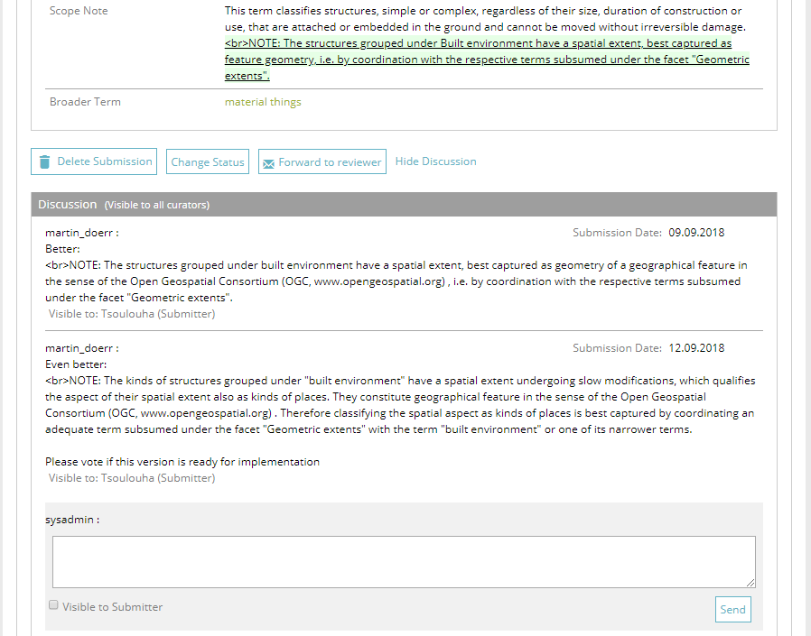
Discussion on Submissions

Slide 11
BBTalk - Submission and Connection Management Tool
Managing BBT content
implementing changes to BBT hierarchies and facets
  allows curators to implement changes on BBT concepts, conforming to the decisions reached regarding the submissions
  allows the preview of the thesaurus release which is under implementation
  allows the release of new versions
  allows the comparison of different versions of BBT
  notifies interested parties of new BBT version releases
Developed and maintained by FORTH-ICS (www.ics.forth.gr).
Current version: www.backbonethesaurus.eu/BBTalk

Slide 12
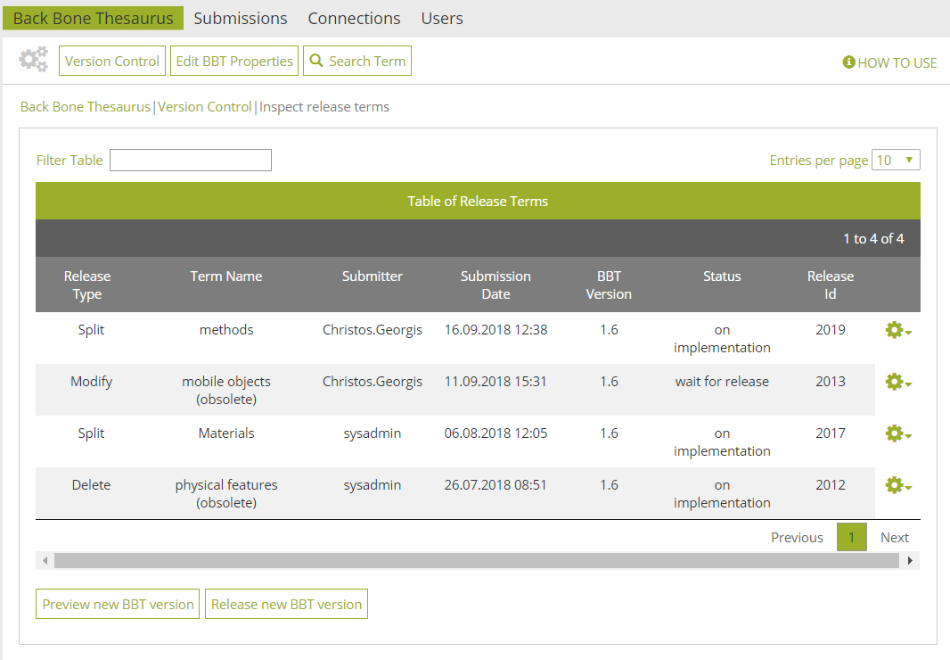
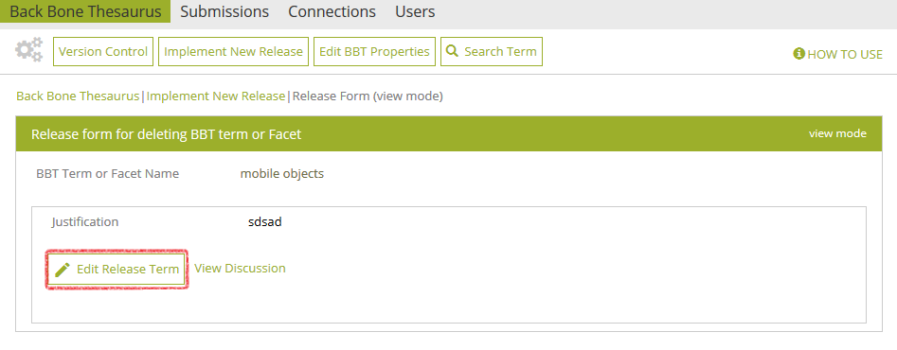
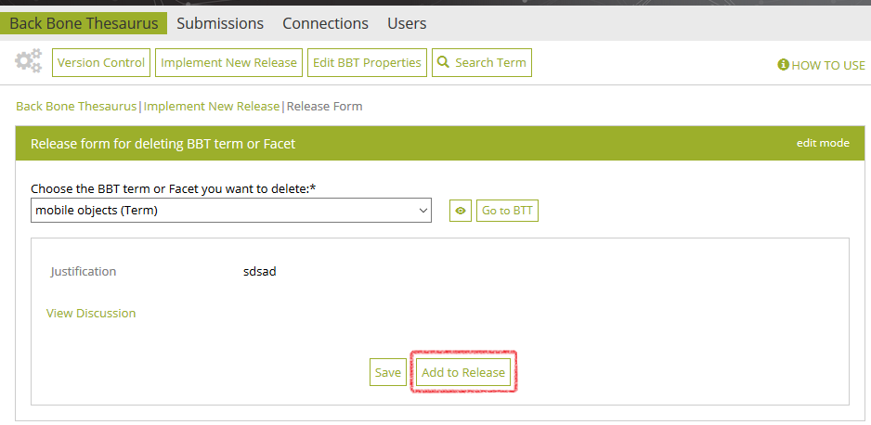
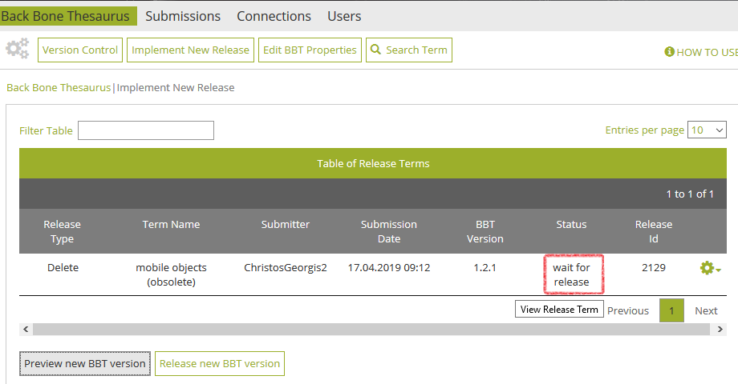
Implementing a new release

Slide 13
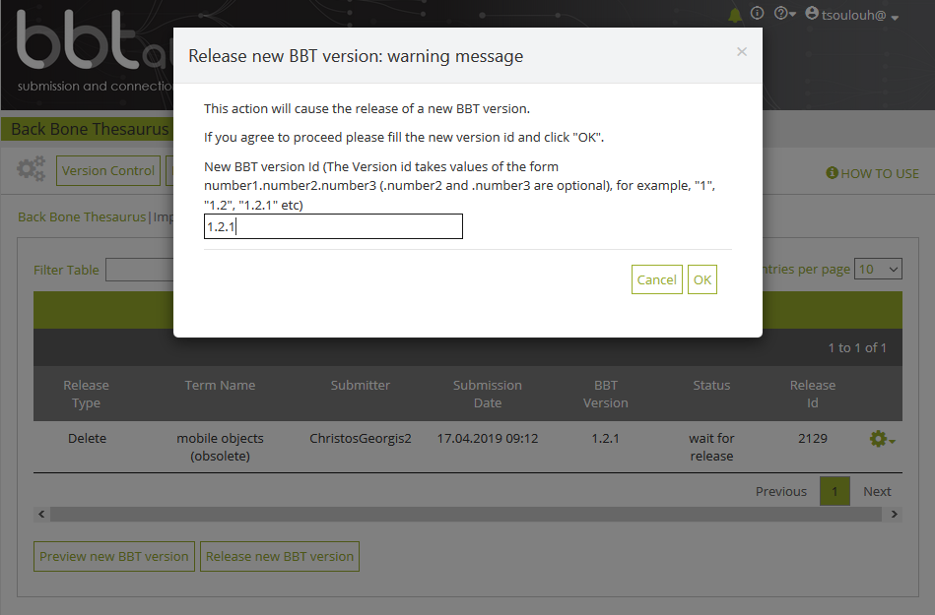
Implementing a new release

Slide 14
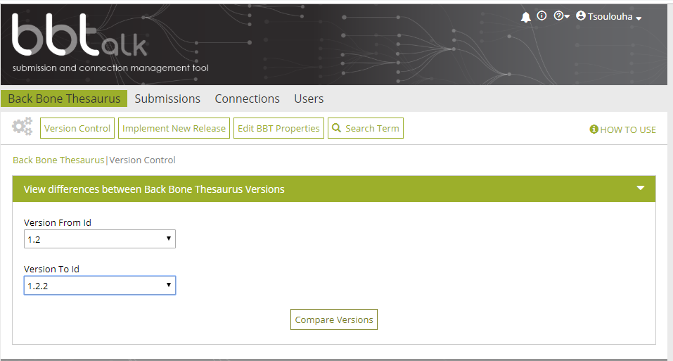
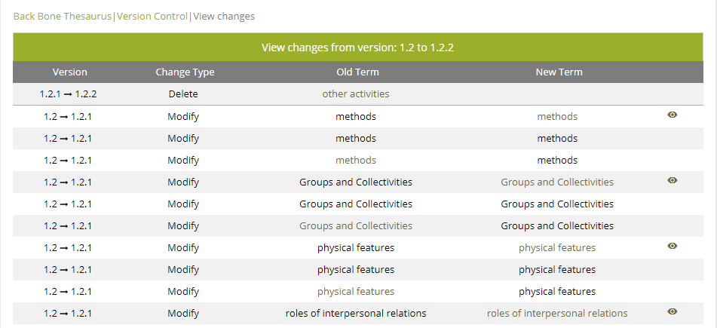
Comparing BBT Versions

Slide 15
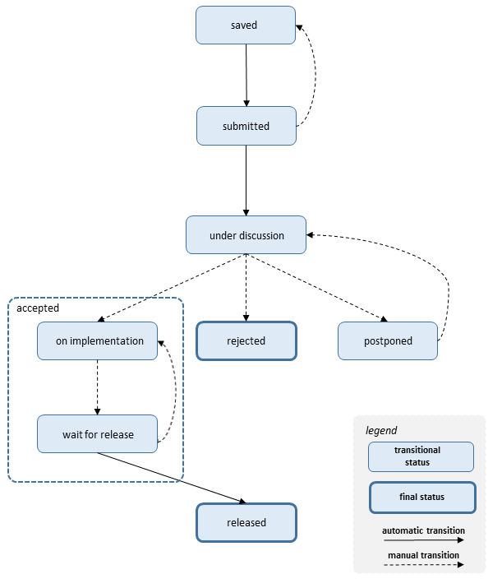
Submission workflow and submission statuses
saved
submitted
under discussion
rejected
postponed
on implementation
wait for release
released

Slide 16
BBTalk – User roles
Contributors: people suggesting changes (requesting additions, deletions or modifications ) on BBT concepts. Contributors can be:
  local thesauri maintainers who wish to link their local thesauri terms to concepts in BBT.
  anyone interested in browsing the BBT terms, their history of submissions and their connections with other thesauri terms.
Curators: people responsible for the maintenance of BBT. Their role is to decide on changes to be made on the BBT and implement them accordingly, taking into account the submissions concerning the current and the previous versions of the thesaurus.
Reviewers: domain experts approached by the BBT curators that are asked to review submissions pertinent to their expertise.
Administrators: The system administrators are responsible for the maintenance of the system information and the system software: manage the new users, take and restore backups, etc.

Slide 17
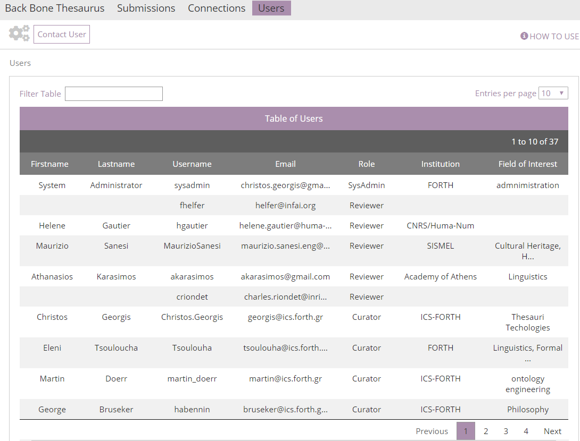
Contacting Users

Slide 18
Integrating the PARTHENOS vocabularies with BBT; the project (1/2)
In what follows we will showcase the functionalities of thesaurus alignment and updating the content of BBT through an actual use case.
PARTHENOS (Pooling Activities, Resources and Tools for Heritage E-research Networking, Optimization and Synergies)
PARTHENOS aimed at bringing together existing Research Infrastructures spanning disciplines such as Linguisitics, History, Archaeology, Cultural Heritage and related fields in order to enable finding and combining information from different domains.
This translates in:
  developing common standards
  creating interoperabilty through semantics
  pooling methods, services and tools

Slide 19
Integrating the PARTHENOS vocabularies with BBT; the project (2/2)
Part of the project (WP: 5, Task: 3) was to identify high-level standardized vocabularies (or, if missing, to create them from scratch) to be used in the data integration activities.
Part of the strategy adopted was to map the resulting vocabularies to the appropriate high-level concept of BBT, and if necessary propose new ones where BBT fell short to accommodate them.
  It is possible that the BBT underspecifies semantic/conceptual distinctions that are particularly prominent in a domain-specific vocabulary. The integration of such a vocabulary with the BBT might call for changes in the overall scope of BBT –manifest by fine-grained distinctions, available even for high-level hierarchies.

Slide 20
Integrating the PARTHENOS vocabularies with BBT; to what purpose?
BBT aims to serve a broad, interdisciplinary community of researchers by allowing an open-ended expansion of federated thesauri through an open, revisable and methodologically clear hierarchy of vocabularies.
Integrating the vocabularies identified for use in the PARTHENOS Entities Model to the established facets and hierarchies of BBT served to:
  publish and share said vocabularies
      (https://isl.ics.forth.gr/parthenos_vocabularies)
  test and validate BBT and the methodology driving it
  test and validate BBTalk Tool
  seek feedback from the community

Slide 21
Integrating the PARTHENOS vocabularies with BBT; the strategies adopted
In total, eleven vocabularies were integrated,
the integration process followed a number of different strategies, depending on whether:
  they fell within the scope of the respective BBT terms, f.i.:
    PARTHENOS Disciplines
    contact point types
  they motivated the introduction of new BBT concepts, f.i.:
    Languages Name Authority List
    Wikipedia Programming Language List

Slide 22
Integrating the PARTHENOS vocabularies with BBT; establishing connections
Integrating vocabularies that fell within the scope of the respective BBT terms involved two different strategies:
  directly linking terminology sets from PARTHENOS to the appropriate branches of the BBT
    PARTHENOS Disciplines (lists professional and scientific domains involved in the Parthenos Project)
  Introducing auxiliary intermediate generalizations in PARTHENOS Entities Vocabularies, which, in turn, were linked into the BBT. This practice ensures that terms from distinct classificatory systems referring to the same real world areas of interest can be searched together with other relevant classifications
    contact point types (lists types of identifiers employed or understood by communication services for all kinds of addresses).
    To this end, a new hierarchy was declared within PARTHENOS, namely identifiers, which encompasses all sorts of symbols that aim to univocally name an in the context of one or more organizations.

Slide 23
Integrating the PARTHENOS vocabularies with BBT; building high level concepts bottom-up (1/2)
Integrating vocabularies that called for declaring new terms in BBT:
  Languages Name Authority List
  Wikipedia Programming Language List
Abstracting away from the items listed in each vocabulary, we derived a set of features that support classifying them as specifications of:
  natural languages and
  programming languages
    a useful generalization over programming languages being formal languages
Both concepts can be said to describe systems of communications comprising of (a) a finite set of elements and (ii) a set of recursive rules to combine them into a potentially infinite array of discrete expressions.

Slide 24
Integrating the PARTHENOS vocabularies with BBT; building high level concepts bottom-up (2/2)
They are differentiated by the fact that:
  natural languages are acquired passively and effortlessly by mere exposure to linguistic input and serve multiple functions, whereas
  formal and programming languages are artificial constructs, learnt through different mechanisms and serve predetermined functions.
    Programming languages especially, require the use of technical devices, thus motivating a subdivision within the domain of formal languages.
Both concepts fall under the designation of conceptual objects (top term):
  they are products of human activity that may –but need not –be supported by the use of technical devices,
  their essence remains the same regardless of the carrier,
  they have the ability to exist on more than one carriers at the same time.
However, they do not fit under any of the existing BBT hierarchies particular to conceptual objects, whence the need to declare new BBT branches to accommodate them

Slide 25
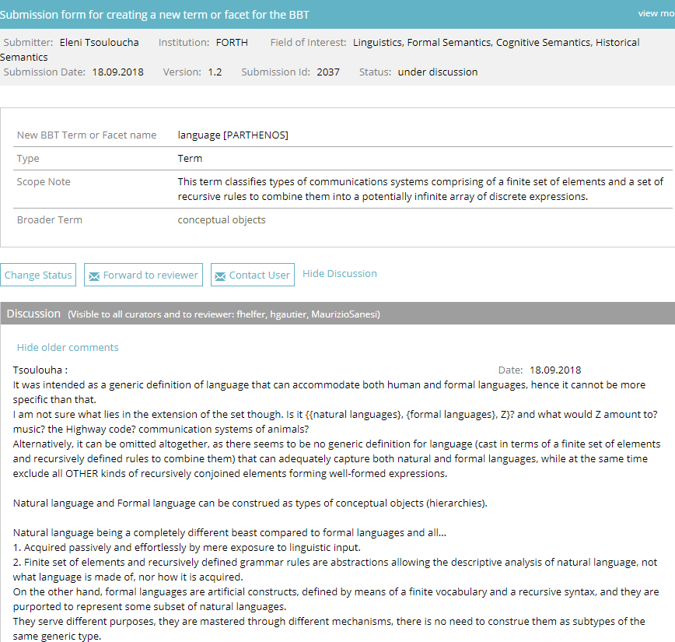
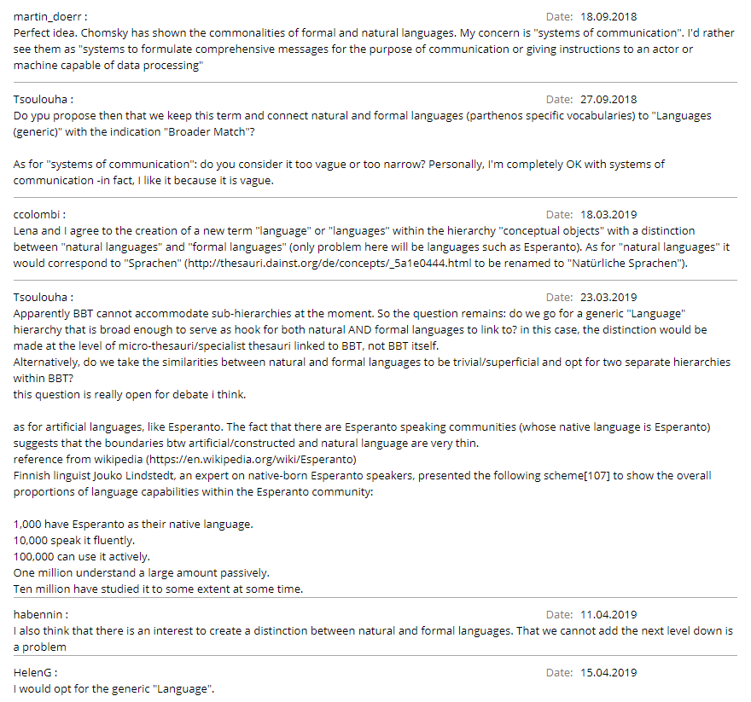
Integrating the PARTHENOS vocabularies with BBT; the discussion functionality
At which point, a process of discussing the extension and expansion of the BBT was launched:

Slide 26
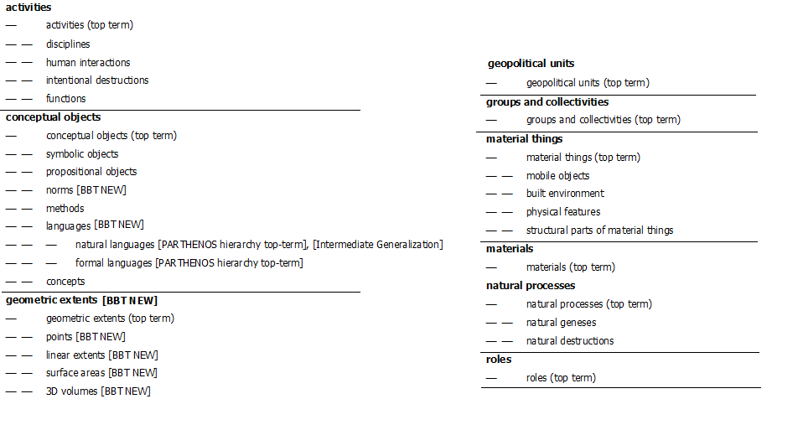
The Structure of BBT re-expressed, following PARTHENOS integration

Slide 27
For more information (including documentation, tutorials), please refer to:
https://www.backbonethesaurus.eu/
https://www.backbonethesaurus.eu/BBTalk/
Thank you!

